Slide 1
Analysis of Yelp Businesses and Reviews
BAIS:6110:0EXB Fall20
Andrew, Bala, Sanoj

Slide 2
Agenda
Project Overview/Problem
Data at a ‘Glance’
Exploratory Data Analysis
Unsupervised and Supervised Learning
Summary

Slide 3
Problem
Project Overview
Group 5 analyzed two data sets from the Yelp application. Yelp is a mobile app that lets customers review business and share their review with the Yelp community. Yelp is a popular tool used all around the world for visitors in new locations that may want to search for something specific or general.
Problem Statement
With available facilities/features for a business we will predict the review that we might get for any business we are going to start . Build a model to suggest the parameters which helps to improve the review of any business.

Slide 4
Data at a ‘Glance’
Business Data - Important features
Business ID and Name
Categories
Geographical Area of Business (Latitude and Longitude)
Address and State
Bit Coin
Credit Card
Counter Service
Parking Lot
Hours Of Operation
Review Stars
Reviews Data - Important features
Review ID
User ID
Business Reviewed
Review Text
Useful
Cool
Funny
Review Stars
Hive Tables And Partitions created
YELP_BUSINESS_GP5
Total number of Business present in the table : 174,567
Total number of unique Business present in the table : 172,335
Total number of business that has reviews : 172,326
Total Number of Business has no reviews yet : 2,242
YELP_REVIEWS_GP5
Total number of Reviews : 5,442,102
Total number of unique Business being reviewed : 289,655
Total number of unique users provided reviews : 1,358,199
Partition Created : YELP_BUSINESS_GP5_COUNTRY_CAT
Region | Category | Count
USA | Restaurant | 51,322
Any | Non-Restaurant | 119,558
NONUSA | Restaurant | 24
NONUSA | Restaurant | 3,678

Slide 5

Data Exploration and Visualization

Slide 6
Data Exploration
What is in the business data?
Where are the restaurants located?
Which restaurants have high occurrences? Are their ratings comparable?
What can we find in the restaurant attributes?
How can we find top restaurants based on our needs?
What can we do next?

Slide 7
Yelp Data Insights
Yelp Dataset contains two files
Yelp_Business - The Yelp business data includes the location (state, city, neighborhood, longitude, latitude, zip code, etc.), working hours on each day, number of reviews, average star rating, and category of businesses.
Yelp_Review – The Yelp review data includes user details, business identifier, review attributes (text, useful, funny, cool etc.) and ratings.
 | Worldwide | Restaurants Worldwide | Restaurants in USA
# of Businesses | 174,568 | 54,630 | 30,309
# of Reviews | 5,442,102 | 3,072,723 | 2,385,657

Slide 8
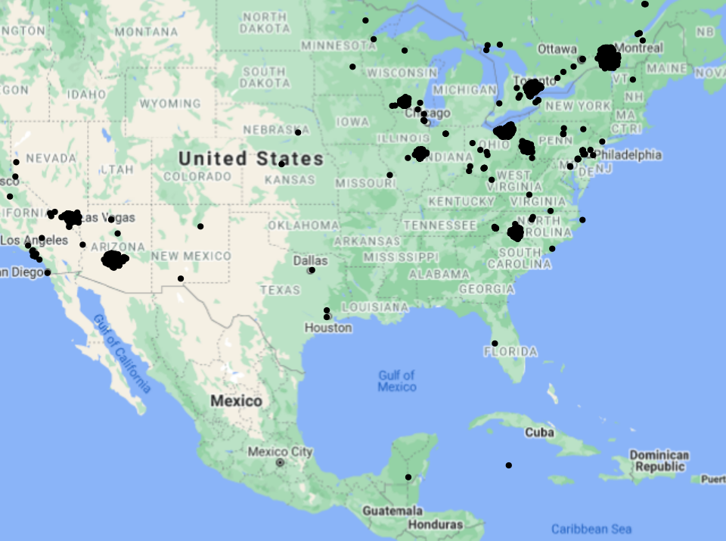
Business Locations
Yelp business data set includes businesses from USA, Canada and Mexico.
USA has more businesses followed by Canada and Mexico.

Slide 9
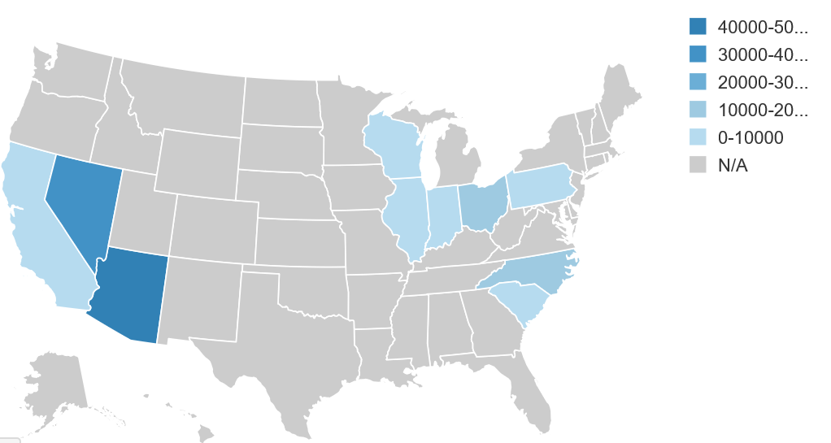
Total Businesses in USA
State | Count
AZ | 52186
NV | 33066
NC | 12942
OH | 12608
WI | 4753
PA | 4294
IL | 1852
SC | 678
CA | 4
IN | 3

Slide 10
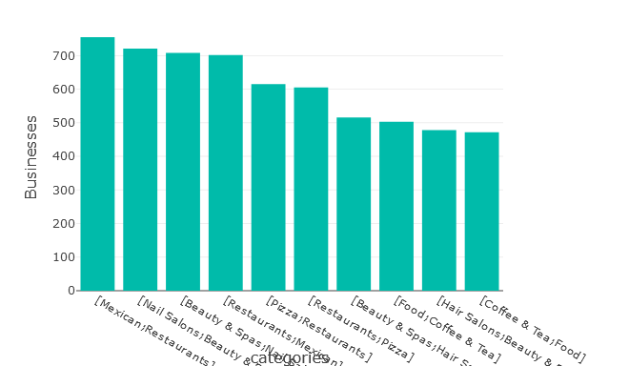
Top 10 business categories within USA
Within USA, restaurants business has highest number of records followed by Spa & Salons.
There are variety of restaurants exists where Mexican restaurants have highest numbers.

Slide 11
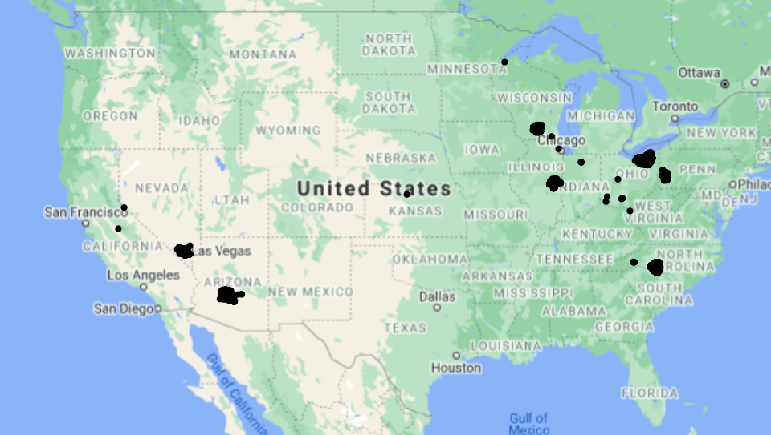
Location of Restaurant businesses in USA

Slide 12
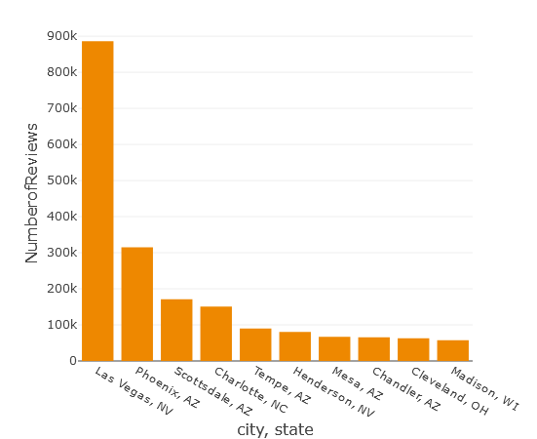
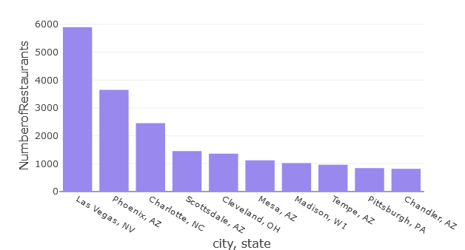
Top 10 Cities in USA - Restaurants and Reviews
Las Vegas, NV has highest number of restaurant businesses, followed by Phoenix, AZ
Restaurants in Las Vegas has received the highest number of reviews.

Slide 13
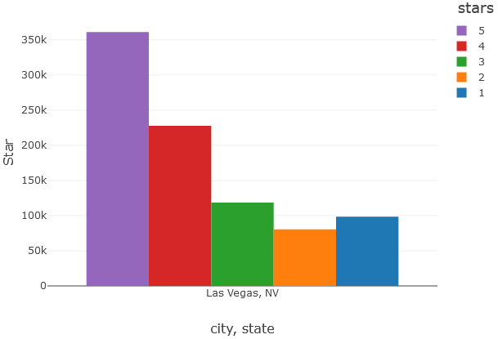
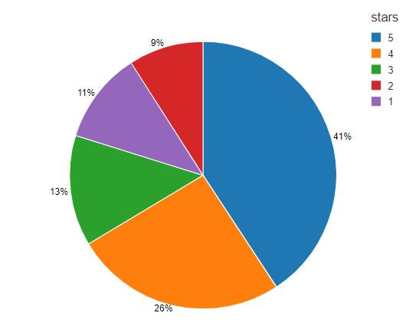
Star ratings received by Restaurants in Las Vegas, NV
360.95K
227.61K
118.6K
80.45K
98.49K

Slide 14
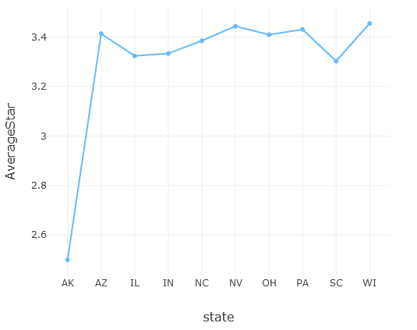
Average stars of Restaurants by States
Average Star Rating ranges from 2.5 to 3.45
Wisconsin state has the highest average rating of 3.4549
Arkansas state has the lowest average rating of 2.5
Illinois and Indiana has ~3.33 as average rating

Slide 15
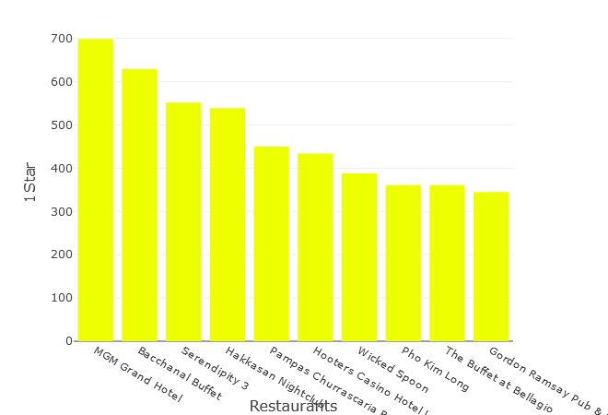
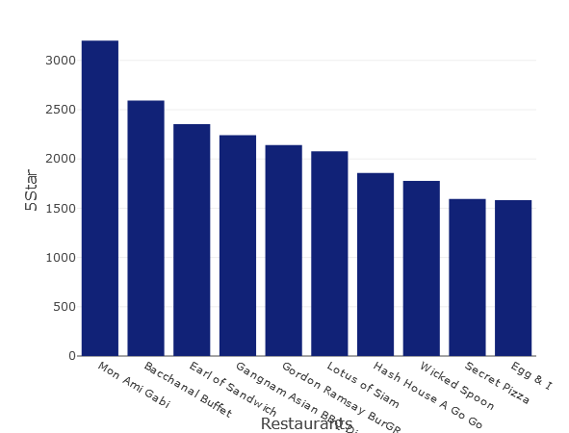
Top 10 restaurants with highest number of 1 & 5-star reviews in USA
Within USA, Mon Ami Gabi is the restaurant has highest number of 5-star reviews followed by Bacchanal Buffet. MGM Grand Hotel has the highest number of 1-star reviews followed by Bacchanal Buffet.
From the above two exploration on review stars, Bacchanal Buffet is the second top restaurant, with both 5-Star and 1-Star reviews. Bacchanal Buffet has a mixed reviews

Slide 16
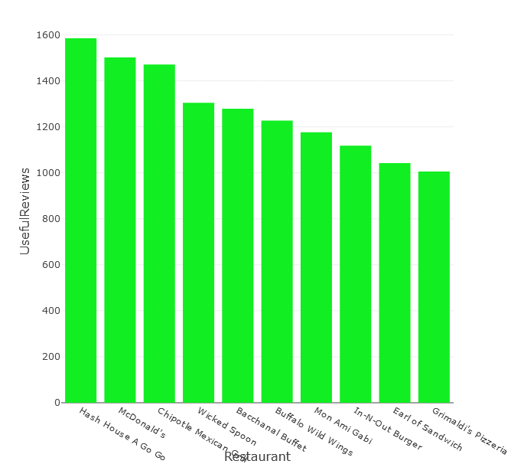
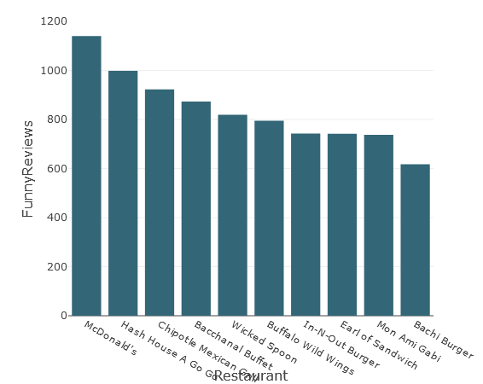
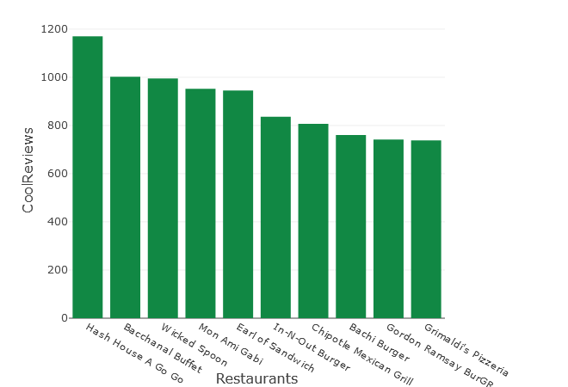
Top10 restaurants with highest number of ‘Useful', ‘Cool’ , ‘Funny’ reviews
Hash House A Go-Go restaurant have received highest number of reviews that are tagged as 'useful’ and ’cool’.
Mon Ami Gabi restaurant has got the highest 5-star ratings; however the reviews are not tagged as useful
Hash House A Go-Go restaurant have received highest number of reviews that are tagged as 'cool'
McDonald's restaurant have received highest number of reviews that are tagged as 'funny'.
Overall Hash House A Go-Go restaurant's reviews are tagged as Useful, Cool as well as Funny.
No relation between 5-star rating and a review getting tagged as Useful or Cool or Funny.

Slide 17
Top10 restaurants with highest number of ‘Useful', ‘Cool’ , ‘Funny’ reviews
Mon Ami Gabi restaurant has got the highest 5-star ratings; however the reviews are not tagged as useful
McDonald's restaurant have received highest number of reviews that are tagged as 'funny'.
Overall Hash House A Go-Go restaurant's reviews are tagged as Useful, Cool as well as Funny.
No relation between 5-star rating and a review getting tagged as Useful or Cool or Funny.

Slide 18
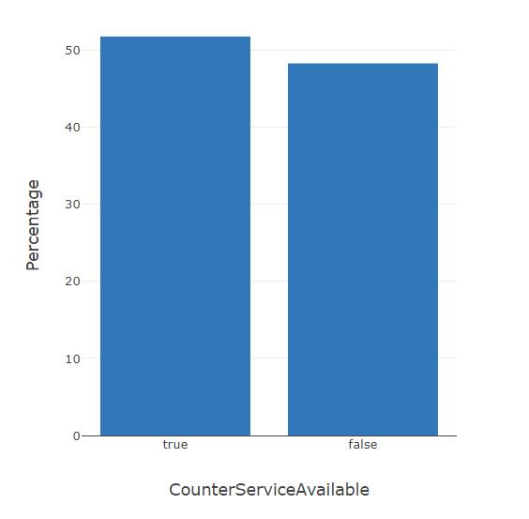
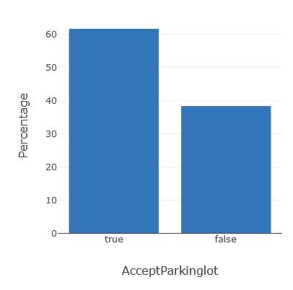
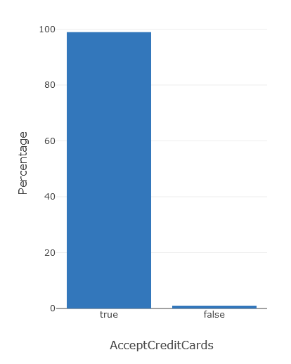
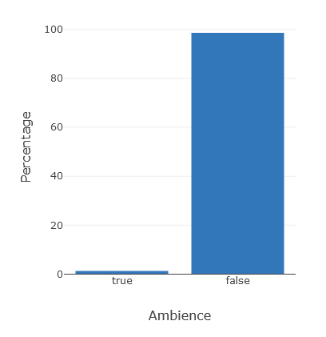
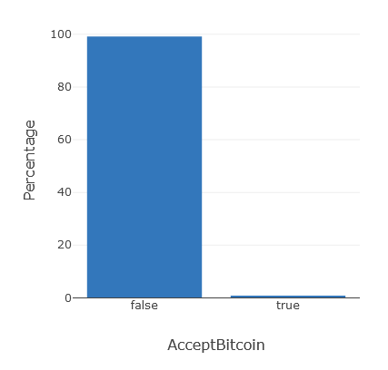
Percentage reviews vs Attributes

Slide 19
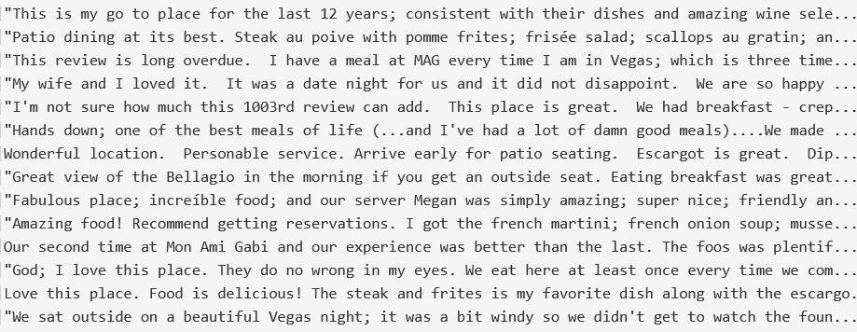
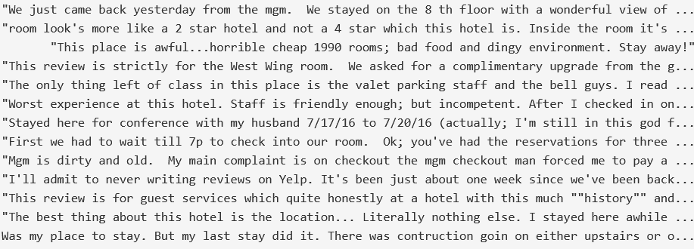
Text Analytics
Highly used words in the reviews for Mon Ami Gabi restaurants in USA
Highly used words in the reviews for MGM Grand Hotel in USA

Slide 20
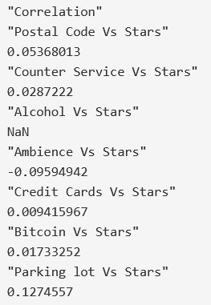
Correlation – Star rating vs Attributes
Star rating vs Attributes | Correlation Coefficient
Parking lot Vs Stars | 0.127
Postal Code Vs Stars | 0.054
Counter Service Vs Stars | 0.029
Bitcoin Vs Stars | 0.017
Credit Cards Vs Stars | 0.009
Alcohol Vs Stars | 0.000
Ambience Vs Stars | -0.010

Slide 21
Model Building and Prediction

Slide 22
Unsupervised Learning Models

Slide 23
Supervised Learning Models
Target variable – Restaurant Review, Good review, or is Restaurant open or closed.
19 variables used in models (i.e. open on certain days, price range, serve alcohol, has parking lot)
All variables cast to integers (no one-hot encoding)

Slide 24
Supervised Learning Models-Results
Regression
Target: Stars
ML Model | MSE | RMSE | MAE | MAPE
Linear Regression | 0.336 | 0.580 | 0.461 | 0.140
Decision Tree | 0.332 | 0.580 | 0.456 | 0.139
Random Forest | 0.333 | 0.578 | 0.460 | 0.139
Gradient Boosted Tree | 0.330 | 0.574 | 0.452 | 0.137
Classification
Target: Good review or Bad Review
ML Model | Accuracy | Precision | Recall
Logistic | 0.545 | 0.545 | 1.000
Decision Tree | 0.583 | 0.549 | 0.933
Random Forest | 0.582 | 0.574 | 0.906
Gradient Boosted Tree | 0.593 | 0.590 | 0.848
Classification
Target: Is Open?
 | Accuracy | Precision | Recall
Logistic | 0.862 | 0.860 | 1.000
Decision Tree | 0.862 | 0.862 | 1.000
Random Forest | 0.582 | 0.574 | 0.910
Gradient Boosted Tree | 0.593 | 0.590 | 0.846

Slide 25
Model Comparison
Not a huge difference between in performance
Leaning towards the less complex models
If we needed to predict a review based on features provided. Linear regression performs just as well as the more complex models.
If we needed to predict whether a business would get a good review or a bad review. GBT performs the best, but there isn’t much difference between GBT or Logistic
If we needed to predict whether a business is open or closed. Logistic models seems to perform as well or better than the other models analyzed.

Slide 27


